Slide 1
DJANGO

Slide 2
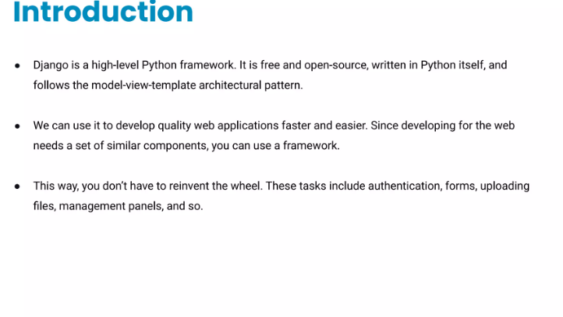

Slide 3
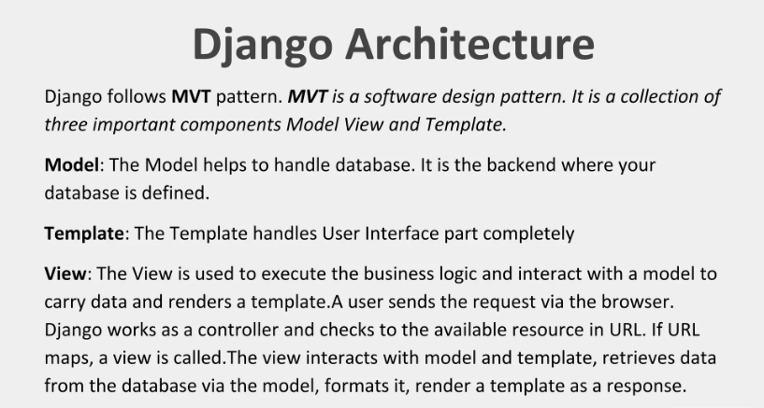

Slide 4
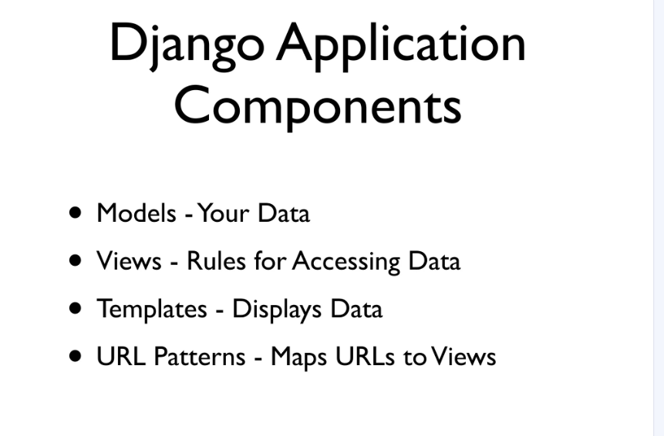

Slide 5
Django is good for making web applications because it is fast, secure, and comes with built-in features like user authentication, admin panel, and database management, which help developers build powerful websites quickly and efficiently.

Slide 6
How to install django:
1. Make sure Python is already installed in our system
python --version
We create an environment to isolate our Django project and its dependencies so that it doesn’t conflict with other projects or system-wide packages.
python –m venv “envname”
Install django by using pip
pip install django
Create a project in django
django-admin startproject projectname
cd Projectname

Slide 7
6.To check if the Django project is installed and running correctly, use:
python manage.py runserver
myproject/ ← 🌟 Base Directory
├── manage.py
├── myproject/ ← Inner project folder (confusingly same name)
│ ├── __init__.py
│ ├── settings.py
│ ├── urls.py
│ └── wsgi.py
7.In the Base Directory
create two folders:
1. template store HTML files only
2.static store CSS,Images,JavaScript files

Slide 8
8.Then ,create app in django project
python manage.py startapp appname
9. So to settings.py
Import os
INSTALLED_APPS=[ ‘eventapp’, app defining
:
: ]
10. TEMPLATES =[
DIRS :[ os.path.join(BASE_DIR,’ template ‘)
]
11.Below STATIC_URL =‘static/’
define :
STATICFILES_DIR =[ os.path.join(BASE_DIR,’ static ‘)

Slide 9
12. In the template folder :
Create html files:
template/
├── base.html
├── index.html
├── about.html
├──events.html
├── booking.html
├── contact.html
static/
├── css
├──js
├──images

Slide 10
13.In event app ,
create a urls.py file
from django.urls import path
from . import views
urlpatterns= [ path(‘’,views.index,name=‘index’)]
14.In event app, views.py
From django.shortcuts import render
Create your view here.
def index(request): uses functions to create views
return render(request,’index.html’)

Slide 11
Base.html
{% block title %}
For adding different titles
{% endblock %}
{% block content %}
For adding different contents
{% endblock %}

Slide 12
load base.html to other html pages by
top of the page :{% extends ‘base.html’ %}
load static files
top of the page : {% load static %}

Slide 13
What is an API (application programming interface)?
API definition and API meaning: An application program interface (API) is a defined set of rules that allows different software systems to communicate.
APIs enable applications to request and exchange information, access features, and integrate services, without needing to understand each other’s internal logic.
They act as a bridge, allowing developers to connect tools, platforms, and products in a standardized and secure way.

Slide 14
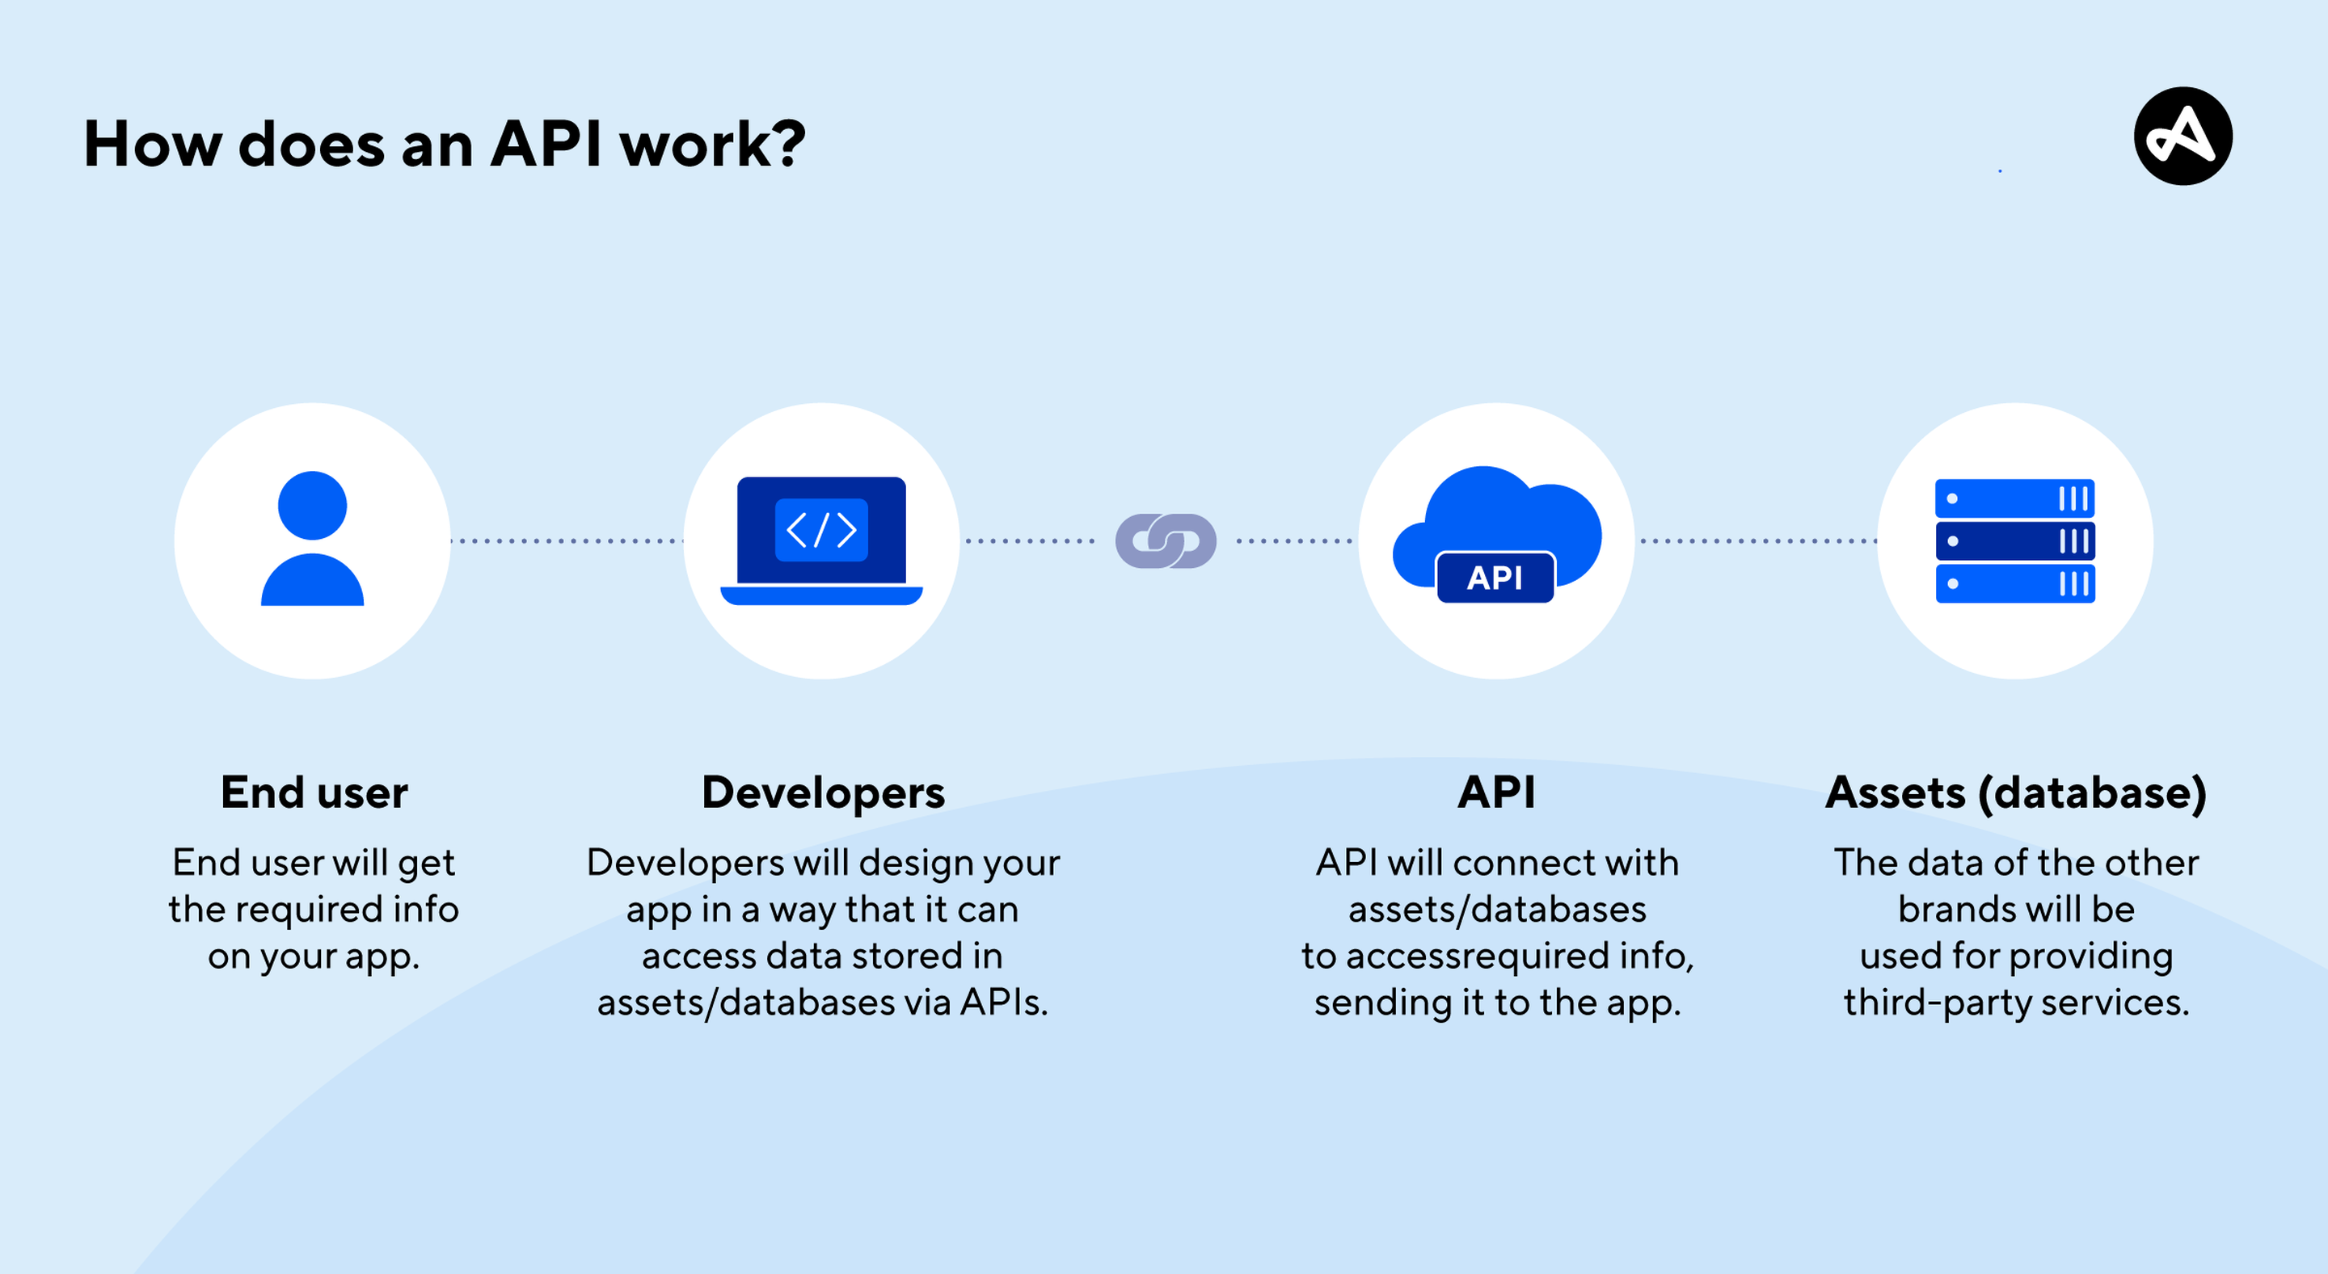

Slide 15
Why are APIs important?
APIs are the backbone of modern software development.
They unlock speed, interoperability, and scalability by allowing developers to plug into existing services instead of building every feature from scratch.
This enables teams to integrate complex functionality, such as authentication, payments, and location services, quickly and reliably.

Slide 16
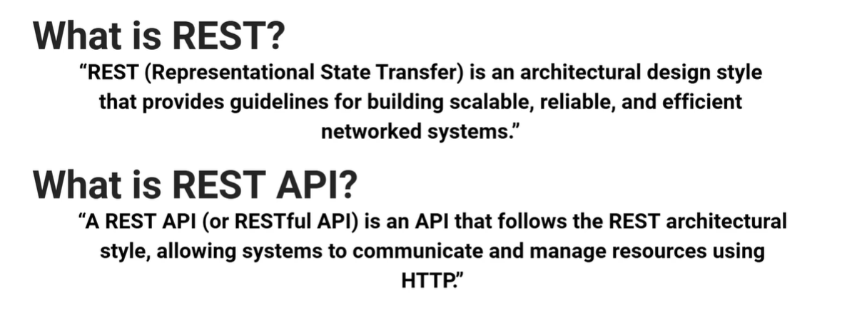

Slide 17
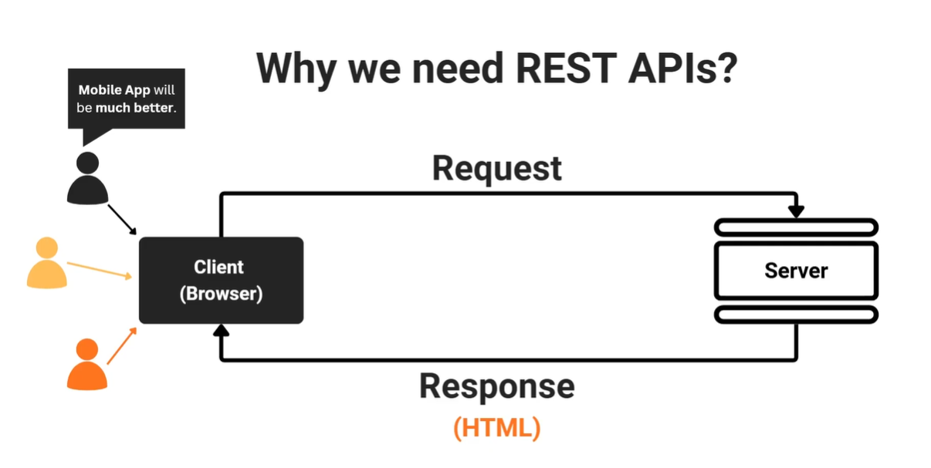

Slide 18
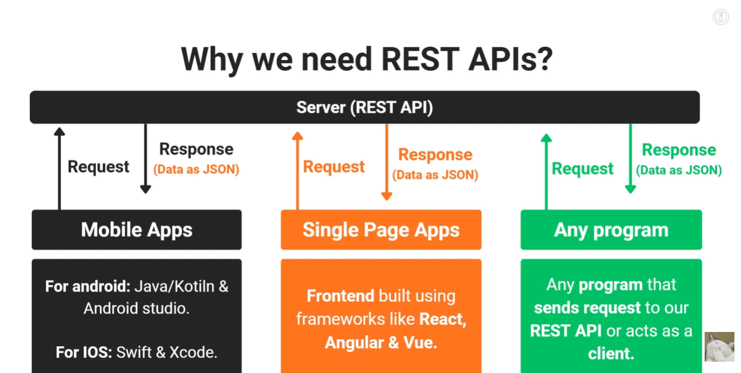

Slide 19
